Slide 1
What is a USB Rubber Ducky?
USB Device that automatically imitates a human user when connected.
Much faster than a human, no typographical errors.
A.K.A. USB Keystroke injector
Similar to a portable macro except automatically trusted
OS independent

Slide 2
What automation excels at
Repetitive tasks
Rapid tasks without human error. Humans think slower.
Tasks requiring huge amounts of data.
Data entry.
No forgetfulness
https://bit.ly/2HMwnOg Infographic Source: McKinsey Global Institute.

Slide 3
January 2018 - IT Job - Developed USB Duckies for automating daily bulk laptop setup. >%60 speed increase.
May 2018 - Developed USB Rubber Ducky programming class / course.
March 3rd 2019 - Realized that the programming skills needed can be automated by a simple app. - Programming course obsolete!
March 11th 2019 -
Developed DuckyTrainer app to convert recorded keystrokes into code.

Slide 4
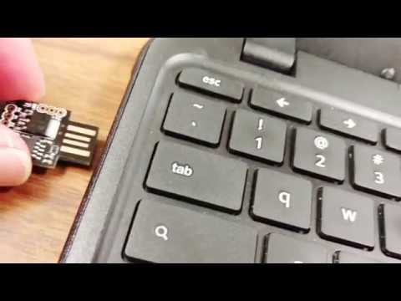

Slide 5
WITHOUT DuckyTrainer | FAST | BLIND | TRUSTED | PLATFORM | CODING
USB RUBBER DUCKY | ✅ | ✅ | ✅ | Android, Mac, Windows, Linux | ✅
MACRO | ✅ | ⛔ | ⛔ | Windows | ⛔
WITH DuckyTrainer | FAST | BLIND | TRUSTED | PLATFORM | CODING
USB RUBBER DUCKY | ✅ | ✅ | ✅ | Windows | ⛔
MACRO | ✅ | ⛔ | ⛔ | Windows | ⛔

Slide 6
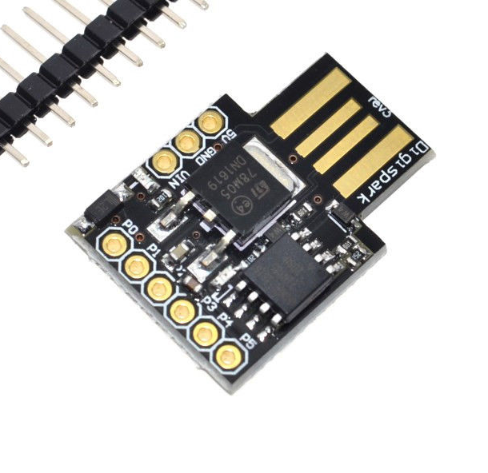
DigiSpark USB Ducky
$2 average cost.
Flashed with Arduino IDE
Not always USB 3.0 compatible

Slide 7
Where to get the parts?
Arduino IDE app from Arduino.cc website (Free $0.00)
DigiSpark from Ebay, AliExpress, or Amazon - Sort by price range not lowest to highest. (~ $2 USD)
DuckyTrainer app
DigiSpark Arduino Addon from http://digistump.com/wiki/digispark/tutorials/connecting (Follow installation instructions on the site)

Slide 8
DuckyTrainer app demo video

